Slide 1
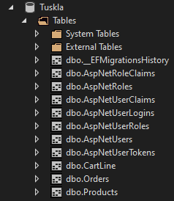
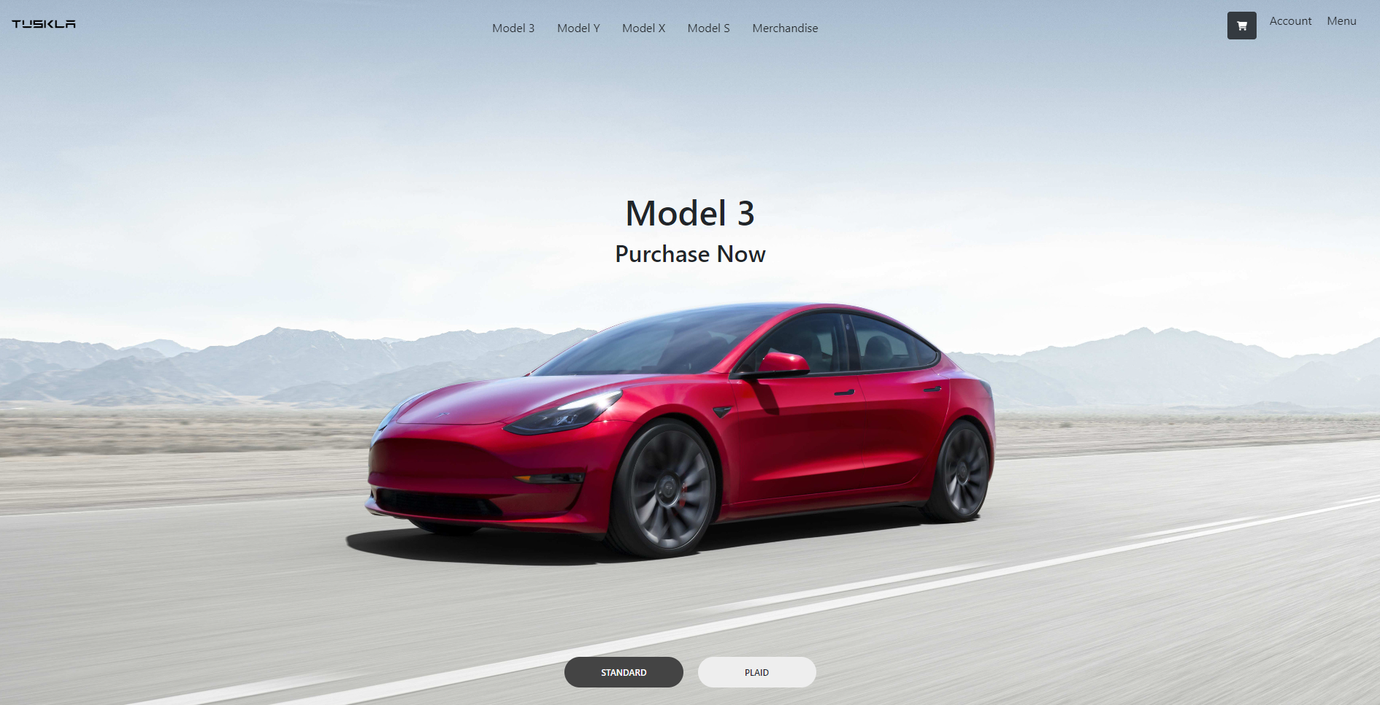

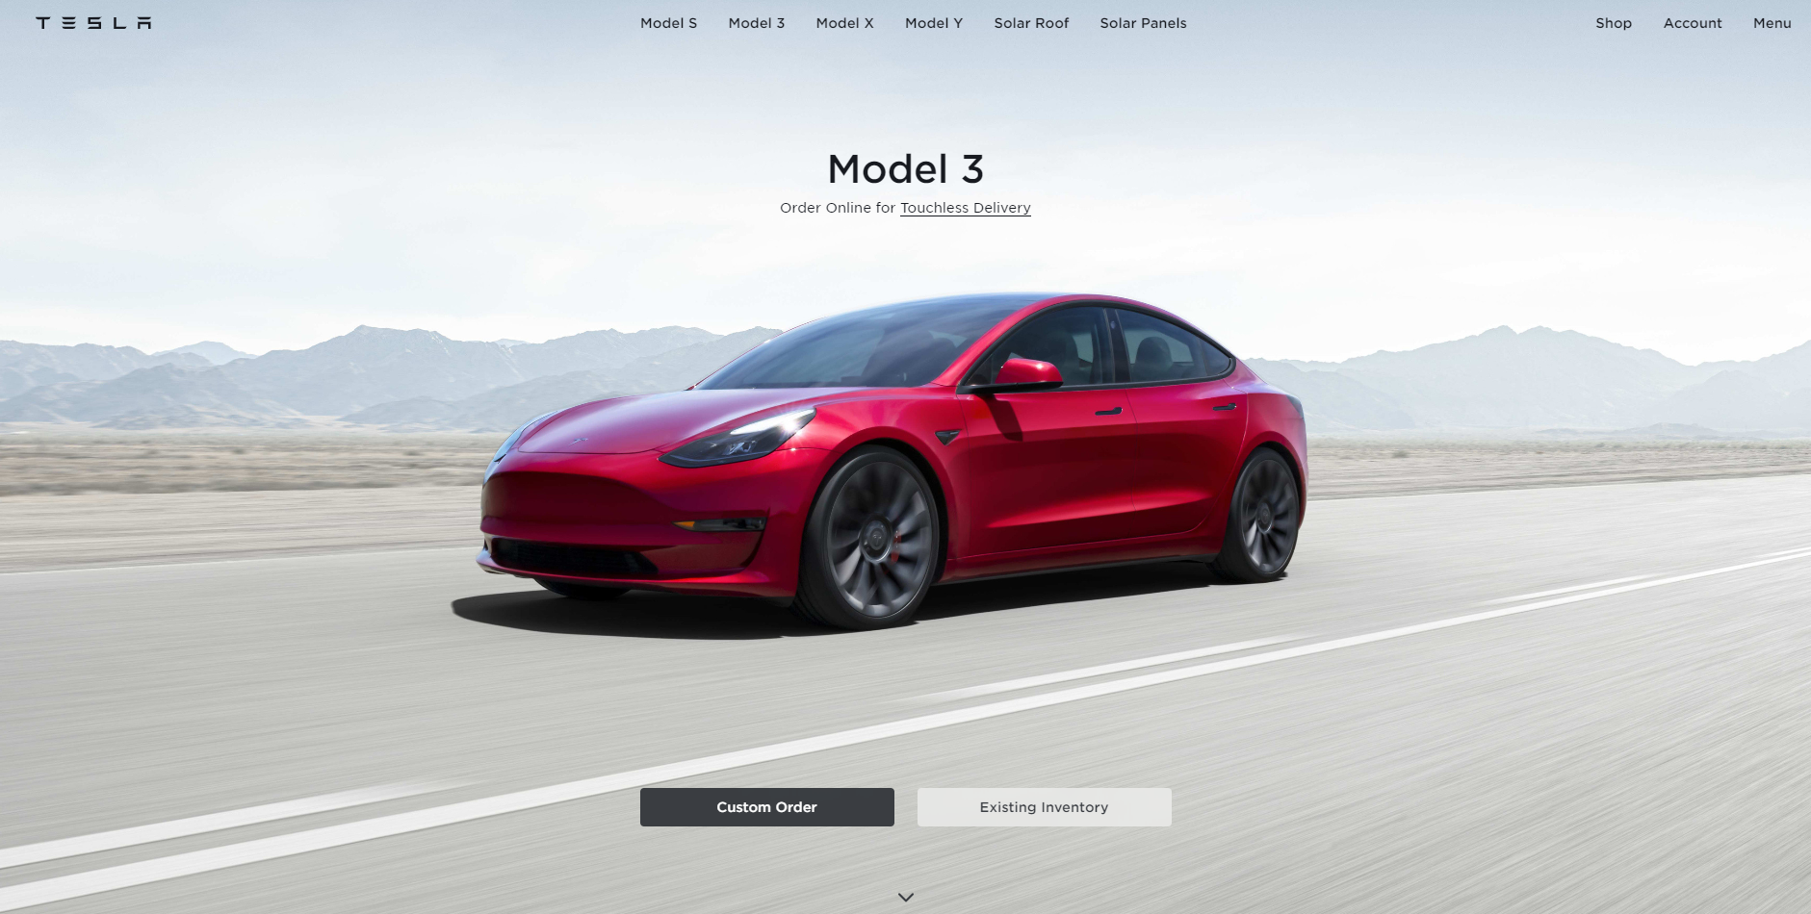
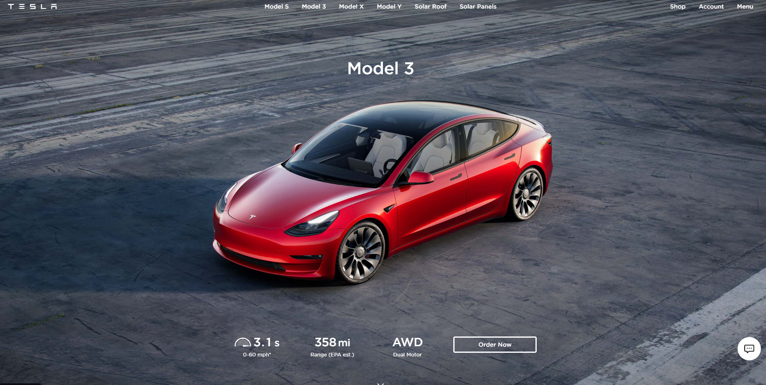
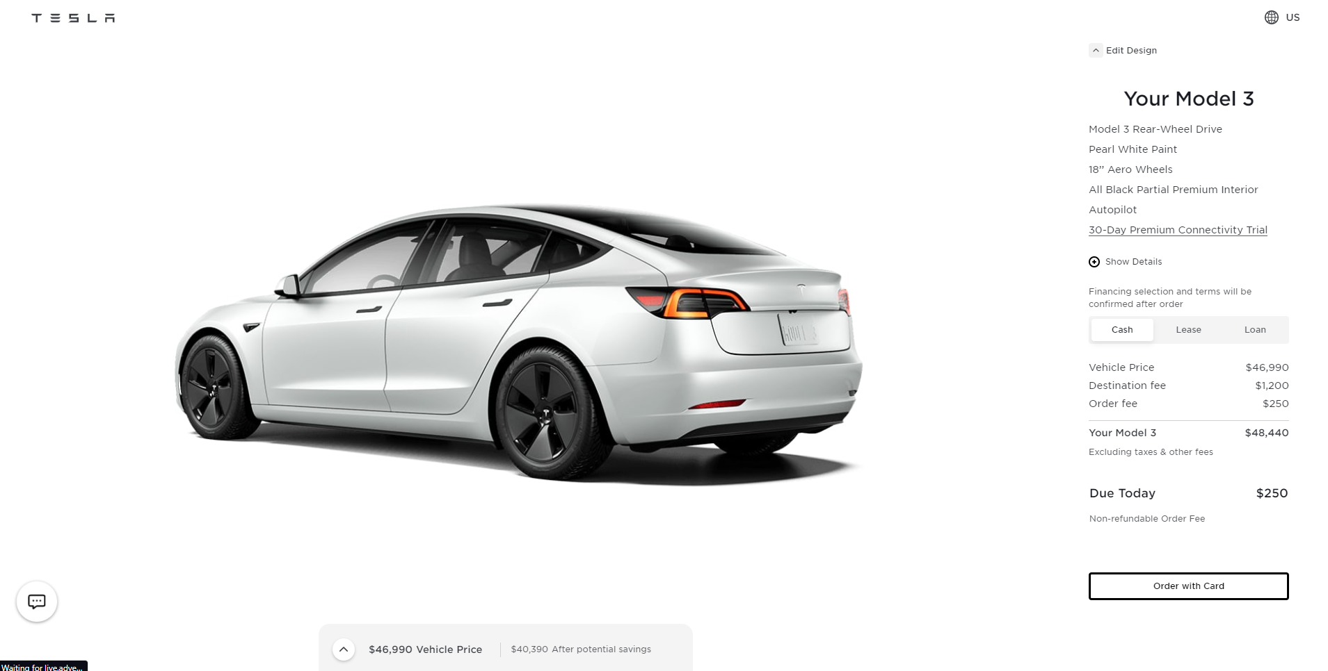
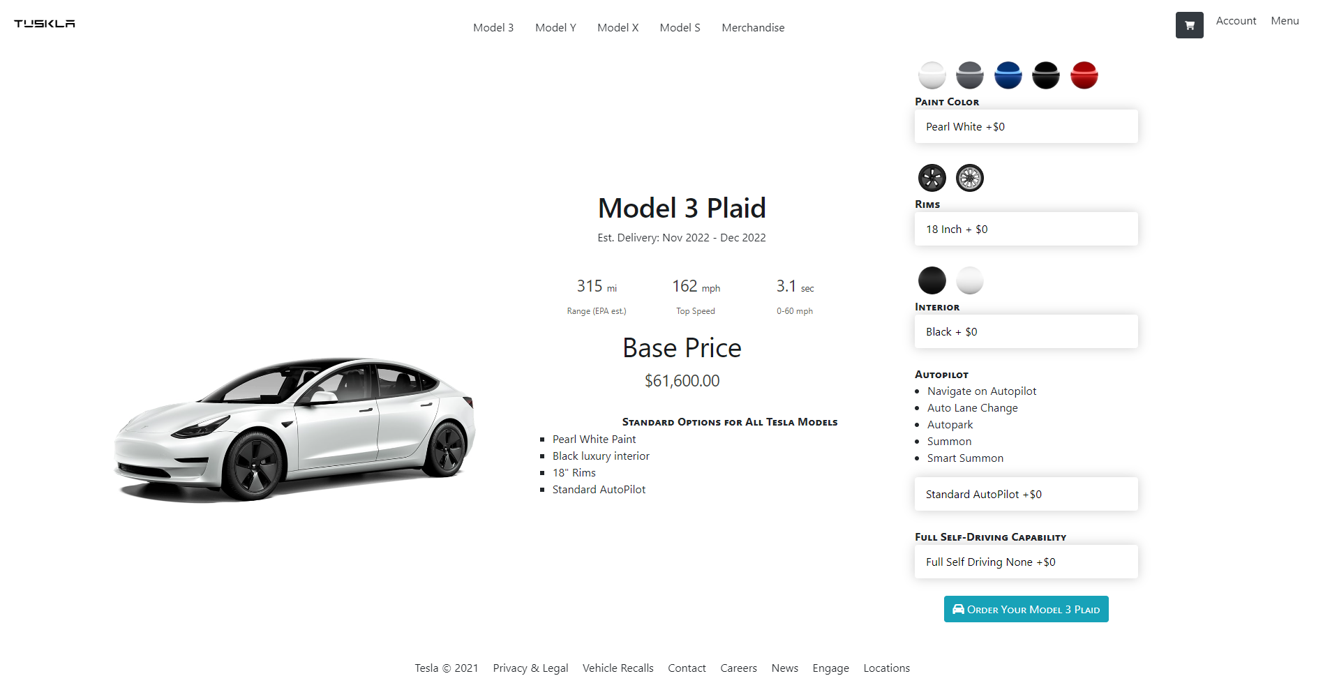
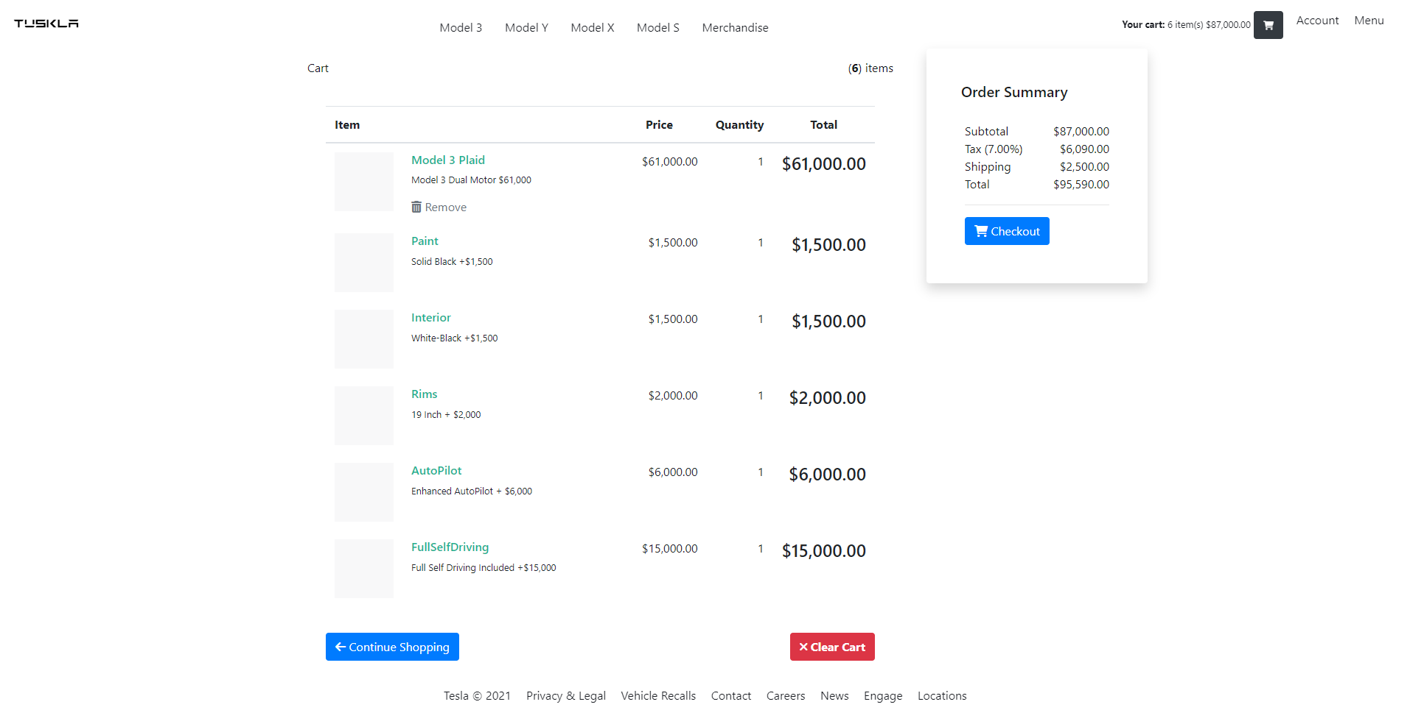












Tesla Case Study and Website Development in .NET Core
Jason Gardner, n01480000@unf.edu
Patrick Nelson, n00158428@unf.edu
Joseph Oconnor, n00081799@unf.edu
University of North Florida Jacksonville, FL USA 32224
INTRODUCTION
MATERIALS & METHODS
CONCLUSIONS
Tesla is primarily a Business to Consumer (B2C) business in the automotive industry that has become the industry standard for electric vehicles due to its supply chain vertical integration and direct-to-customer sales.
Tesla’s website was designed with simplicity and minimalism in mind but is backed by technologies built around React.
We developed the website for a fictional company, Tuskla, in the spirit of Tesla’s minimalistic web design, using .NET, C#, JavaScript, MSSQL, HTML, and CSS.
Tesla was researched by the team and a report and presentation were generated that describe in detail the working of Tesla as a successful automotive industry first-mover in electric vehicles.
Tesla’s suppliers, partners, employees, and customer relationships were modeled and written into a report and presentation.
The Tuskla page was written using the .NET 3.1.0 SDK, using an MVC design, and contains the JavaScript libraries Bootstrap, Font-Awesome, jQuery, and the jQuery-validation.
The project uses more than six (6) controllers, 18 models, and 43 views. The back end holds user and site data contained in four (4) databases and JSON data, queried using Newtonsoft JSON and LINQ.
In conclusion, the project asked us to analyze Tesla's strategy, business mode, business process model, and web systems from which our team would create a fictitious vendor's website.
We developed this using .NET Core and Microsoft SQL Server. The MVC model is geared well towards web design. Controllers receive requests from users, use models to access and manipulate data, and return
views to the users.
OBJECTIVES
Analyze Tesla’s business strategy, business model, business process model, and web systems.
Develop a .NET Core MVC Web Page implementation for an eCommerce automobile vendor in the style of Tesla.
REFERENCES
[1] Tesla Inc., "Tesla," Tesla, [Online]. Available: https://www.tesla.com/. [Accessed 18 November 2022].
Tesla eBusiness Model
Tuskla .NET Core Website Home Page
RESULTS
The Tuskla home page is an experience that closely emulates Tesla’s design. Users are only three steps away from ordering a vehicle when they arrive on the home page. Pages about other products and information, while readily available through footer and menu links, are not the primary focus.
MVC design patterns using .NET Core can create websites with user experiences consistent with web design using modern JavaScript-based libraries.
Tesla.com Web Page [1]
DELIVERABLES
ACKNOWLEDGEMENTS
Tesla Case Study
Tesla Case Study PowerPoint
Symposium Poster
Symposium Presentation
Tuskla .NET Core Vehicle Design Page
Tuskla .NET Core Cart Page

